Slide 1
Ch-5
Introducing the Java EE Platform

Slide 2
Introduction
Java is a
platform-independent programming language
secure and robust applications
may run on a single computer or may be distributed among servers and clients over a network
Problems related to hardware, network and the OS

Slide 3
Enterprise Architecture
Enterprise architecture helps in understanding the structure of an enterprise application and can be broken down into three fundamental logical layers
The presentation layer
The business logic layer
The data storage and access layer

Slide 4
The presentation layer :
Displays the elements that store the data of users and collects data from the users.
It is generally considered as the user interface,
It includes the part of the software that creates and controls required to design an interface for a user and validates the action of the user
The business logic layer :
Helps an application to work with and handle the processing of business logic.
Programming part considered in Business Logic layer
The data storage and access layer :
Helps business application to read and store data.

Slide 5
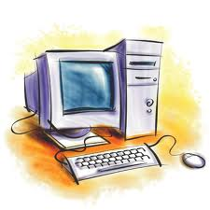
Single-tier Architecture
The single tier architecture consists of the presentation logic, the business rules, and the data access layers in a single computing architecture
Applications created on single tier architecture are relatively easy to manage and implement data consistency, as data stored at a single location
The only problem is that such application cannot be handle multiple users and it can not provide an easy means of sharing data across an organization
User Interface Layer
Business Layer
File/ Database Layer

Slide 6
The 2-tier Architecture
separates the data access layer and business logic layer.
This type of architecture is generally data driven,
application located at local machines and database is located in server at specific location
the processing load is entrusted to the client,
the server simply controls the traffic between the application and data access layer
The client-server solution also allows multiple users to access the database at the same time as long as they are accessing data in different parts of the database.

Slide 7
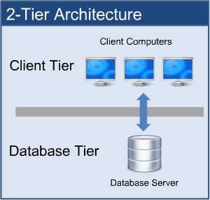

Slide 8
The 3-tier Architecture
In the 3-tier architecture , an application is virtually split into three separate logical layers
First tier : - Refers to the presentation layer, which consists of a Graphical User Interface (GUI) to interact with a user
Middle tier : - Refers to the business layer, which consists of the business logic for an application. The middle tier represents the code that is called by a user through the presentation layer to retrieve data from the data layer
Third tier : - Refers to the data layer, which contains the data access logic needed for the application

Slide 9
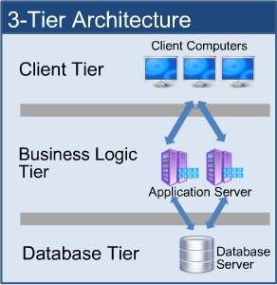
As the business logic and the user interface at different layers, it adds a lot of flexibility when designing an application
By using the 3-tier architecture, multiple user interfaces can be built and deployed without changing the application logic

Slide 10
Advantages
High performance, lightweight persistent objects
Scalability – Each tier can scale horizontally
Performance – Because the Presentation tier can cache requests, network utilization is minimized, and the load is reduced on the Application and Data tiers.
High degree of flexibility in deployment platform and configuration
Better Re-use
Improve Data Integrity
Improved Security – Client is not direct access to database.
Easy to maintain and modification is bit easy, won’t affect other modules
In three tier architecture application performance is good.
Disadvantages
Increase Complexity/Effort

Slide 11
Little comparison
 | 1-Tier | 2-Tier | Multi-Tier
Benefits | Very simple No server needed | Good security More scalable Faster execution | Exceptional security Fastest execution Very scalable
Issues | Poor security Multi user issues | More costly More complex | Very costly Very complex
Users | Usually 1 (or a few) | 2-100 | 50-2000 (+)

Slide 12
N-tier Architecture
Fundamental Services : e.g. Database, Directory Services
Business Domain Tier : Application Server, e.g. Java EE EJB, DCOM or CORBA Service Objects.
Presentation Tier : e.g. Java Servlets/JSP, ASP, PHP.
Client Tier : Thin clients like HTML Pages on Browsers and Rich Clients like Java WebStart & Flash.
The move to being called N-Tier is a reflection of the move to component architectures from older client-server to first 3-Tier then 4-Tier. The defining characteristic is a clearly defined interface and/or separation of responsibility.

Slide 13
Java Technology Levels
Java Platform, Standard Edition
Java SE (J2SE)
core language
Java Platform, Micro Edition
Java ME (J2ME)
targeted at small devices
PDAs
cell phones
Java Platform, Enterprise Edition
Java EE (J2EE)
targeted at enterprise deployments
persistence
distributed systems
web-based applications
transactions
security
Note: Java Technology has gone through a recent name change.
J2SE 5.0 stayed J2SE 5.0
J2SE 6.0 is called Java SE 6
J2EE 5.0 became Java EE 5
J2ME will become Java ME

Slide 14

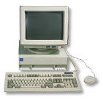
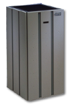


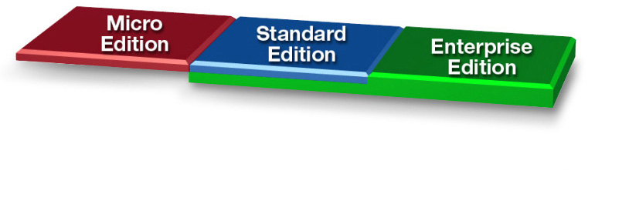
The Java™ Platform
Java Technology
Enabled Devices
Java Technology Enabled Desktop
Workgroup
Server
High-End
Server
Notes:
By now, most of you know there are three flavors of Java - Micro Edition, Standard Edition, and Enterprise Edition. These three flavors of Java represent three distinct target market segments each of which has unique issues and requirements that need to be addressed somewhat differently.
Micro Edition addresses of market segment of small devices such as PDAs, cell phones and settop boxe, which are typically constrained in terms of memory space and processing power.
Standard Edition represents the Java that we all know and love, a Java for desktop and workgroup server environments that require a full feature functionalities including rich graphical user interface.
Enterprise Edition covers the Java platform for developing and deploying enterprise qualitiy applications which are typically transactional, reliable and secure.
Also note that the “Enterprise Edition” box in the graphic extends into the standard edition, that is, Enterprise edition is built over standard edition.

Slide 15
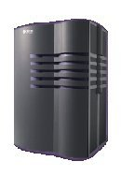
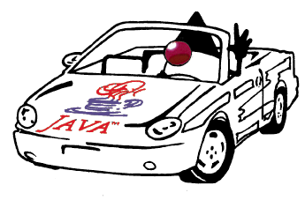

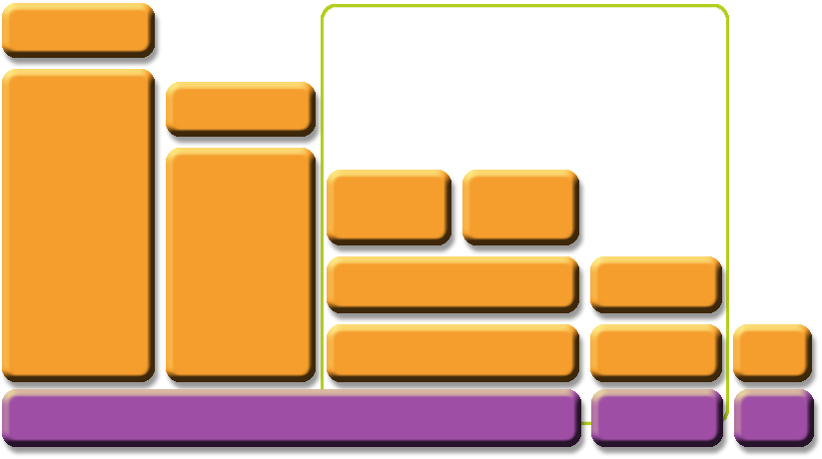



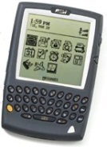
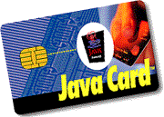
The JavaTM Platform
Java 2 Platform Micro Edition
(J2METM)
Optional
Packages
Optional
Packages
Java 2
Enterprise
Edition
(J2EE)
Java 2
Standard
Edition
(J2SE)
Personal
Basis Profile
Personal Profile
Foundation Profile
MIDP
CDC
CLDC
Java Card APIs
JVM
KVM
CardVM
* Under development in JCP
Notes:
This is another picture that shows three flavors of Java technology. Java is being used at JavaCard at one end and at the supercomputer at the other end.
The key point in this picture is that the syntax and semantics of Java programming language is preserved regardless of which edition you use. And regardless where it is being used, it provides the secure, portable, and robust application development and deployment platform.

Slide 16
Introduction to J2EE
The Java EE platform is built on top of the Java SE platform. The Java EE platform provides an API and runtime environment for developing and running large-scale, multi-tiered, scalable, reliable, and secure network applications.
The benefits of an enterprise application are helpful, even essential, for individual developers and small organizations in an increasingly networked world.
The features that make enterprise applications powerful, like security and reliability, often make these applications complex. The Java EE platform is designed to reduce the complexity of enterprise application development by providing a development model, API, and runtime environment that allows developers to concentrate on functionality.

Slide 17
Features
Platform Independence
Managed Objects
Reusability
Modularity
Simplified Enterprise JavaBeans(EJB)
Enhanced Web Service
Support for Web 2.0

Slide 18
Java EE APIs and Versions
J2SE v5.0
JDBC, JNDI, RMI
Java Persistence 1.0
Common Annotations 1.0
EJB3.0
JMS 1.1
JTA 1.1
Servlet 2.5
JSP 2.1
StAX 1.0
Web Services 1.2
Web Services Metadata 2.0
JAX-WS 2.0
JAX-RPC 1.1
SAAJ 1.3
JAXR 1.0
JSTL 1.2
JSF 1.2
JSP Debugging 1.0
Java EE Management 1.1
Java EE Deployment 1.2
JACC 1.1
Connector 1.5
JavaMail 1.4
JAF 1.1

Slide 19
Container
A Java EE container act as a runtime interface between the application components and the low-level platform-specific functionality that support the components
Java EE containers provide deployment, management, and execution support for application components
Java EE 6 containers provide service as well as an execution environment for the components to be deployed on the server
Different application components are installed in their respective containers during deployment; these containers act as interface between the components and the low-level platform-specific functionality that support the components.

Slide 20
Container Types
During the deployment of a Java EE application, the components of the application are installed in the Java EE server.
The Java EE server is used to execute the application; which contains EJB and web components
Java EE containers can be categorized.

Slide 21
EJB container : - Allows us to execute all enterprise beans for a Java EE application. Enterprise bean and their containers run on the Java EE server
Web Container : - Allows us to execute all JSP tags and servlet components for Java EE application. Web components and their containers run on the Java EE server
Application client container :- Allows us to execute all application client components for Java EE application. Application clients and their containers run on the client machine
Applet container : - Allows us to execute an applet. The Applet container is a combination of the web browser and Java plug-in running together on the client machine

Slide 22
HTTP Protocol
Hyper Text Transfer Protocol takes part in web browser and web server communication
Follows request response model.
Client makes request for desired web page by URL in address bar, web server give response by returning web page.
HTTP request message structure
<start line>
<Header fields>
<Blank Line>
<Message Body>

Slide 23
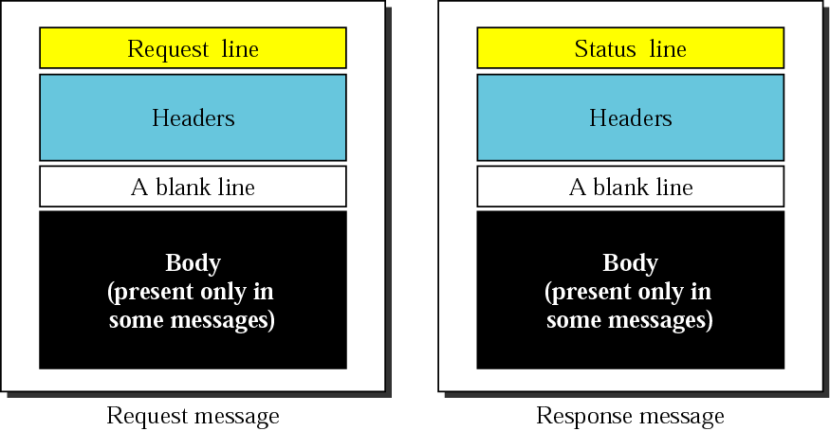
Request and response messages

Slide 24
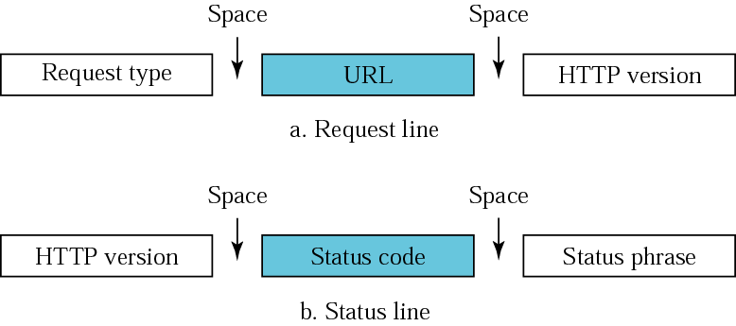
Request and status lines

Slide 25
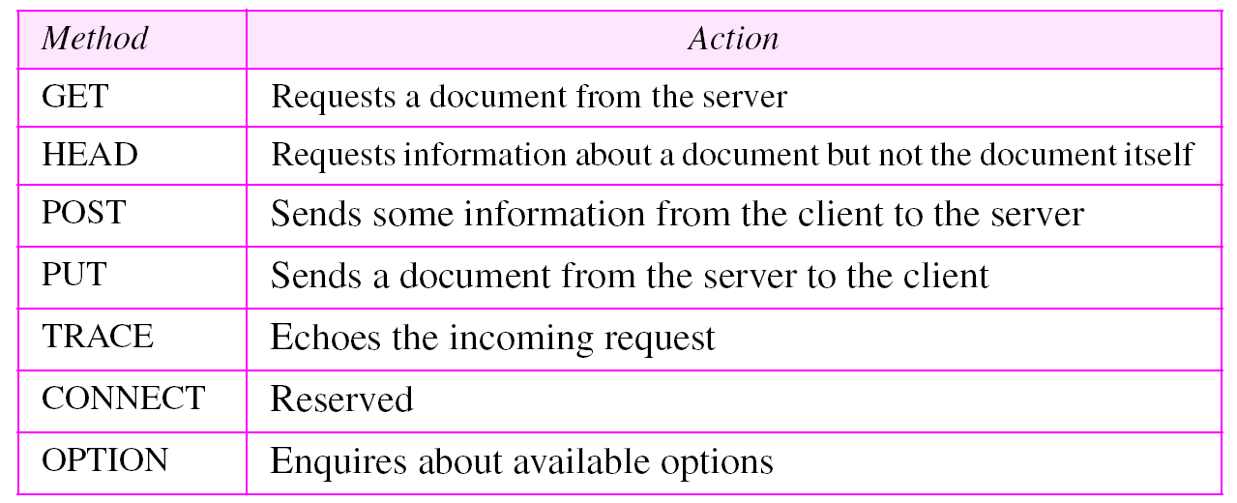
Methods

Slide 26
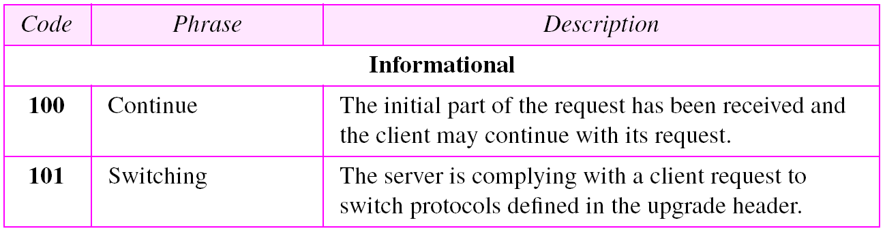
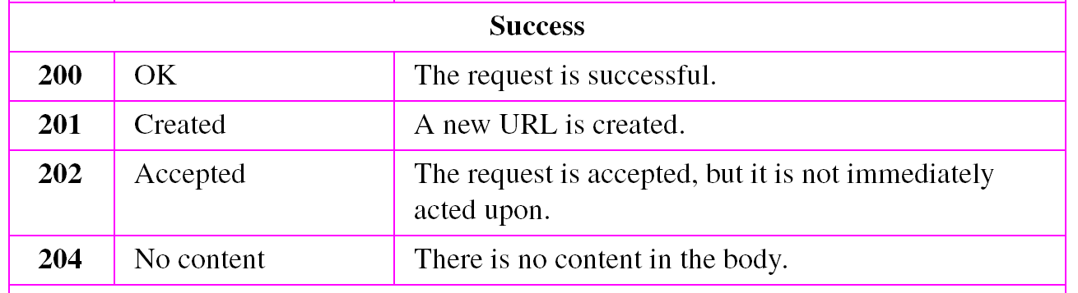
Status codes

Slide 27
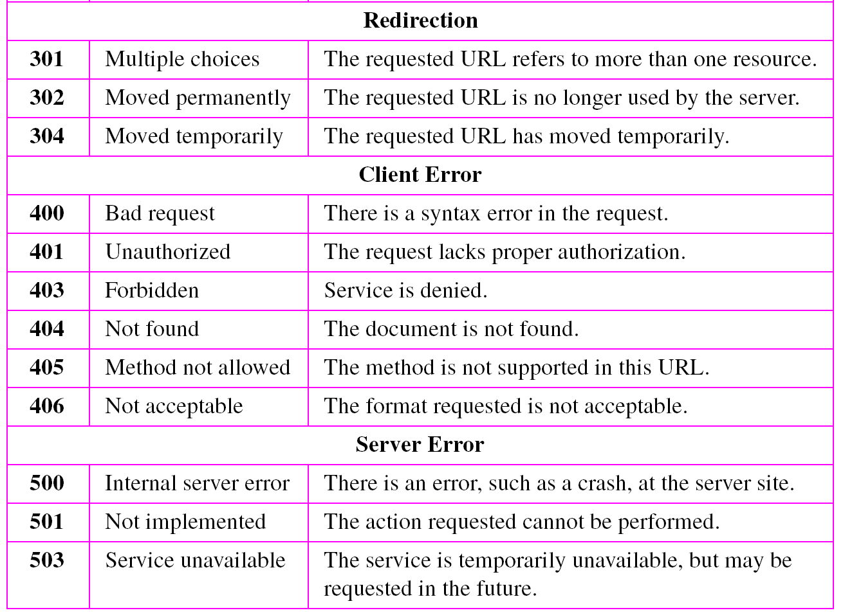
Table 22.2 Status codes (continued)

Slide 28
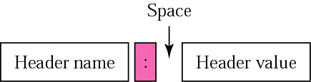
Header format

Slide 29
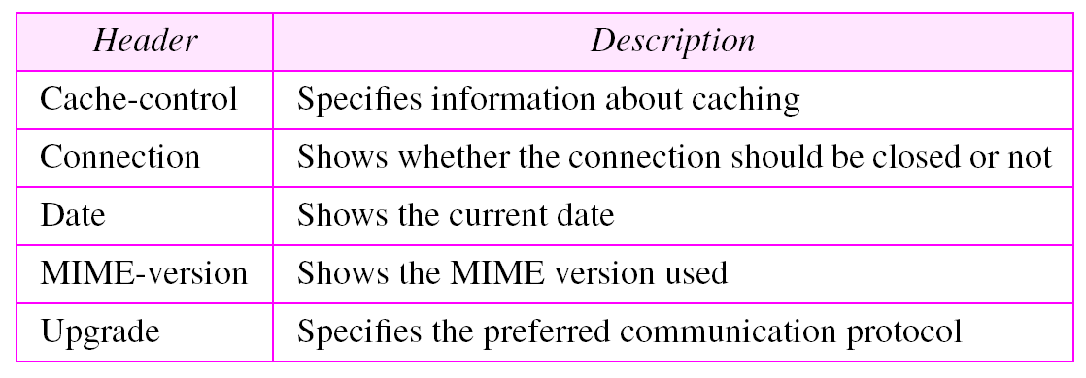
General headers

Slide 30
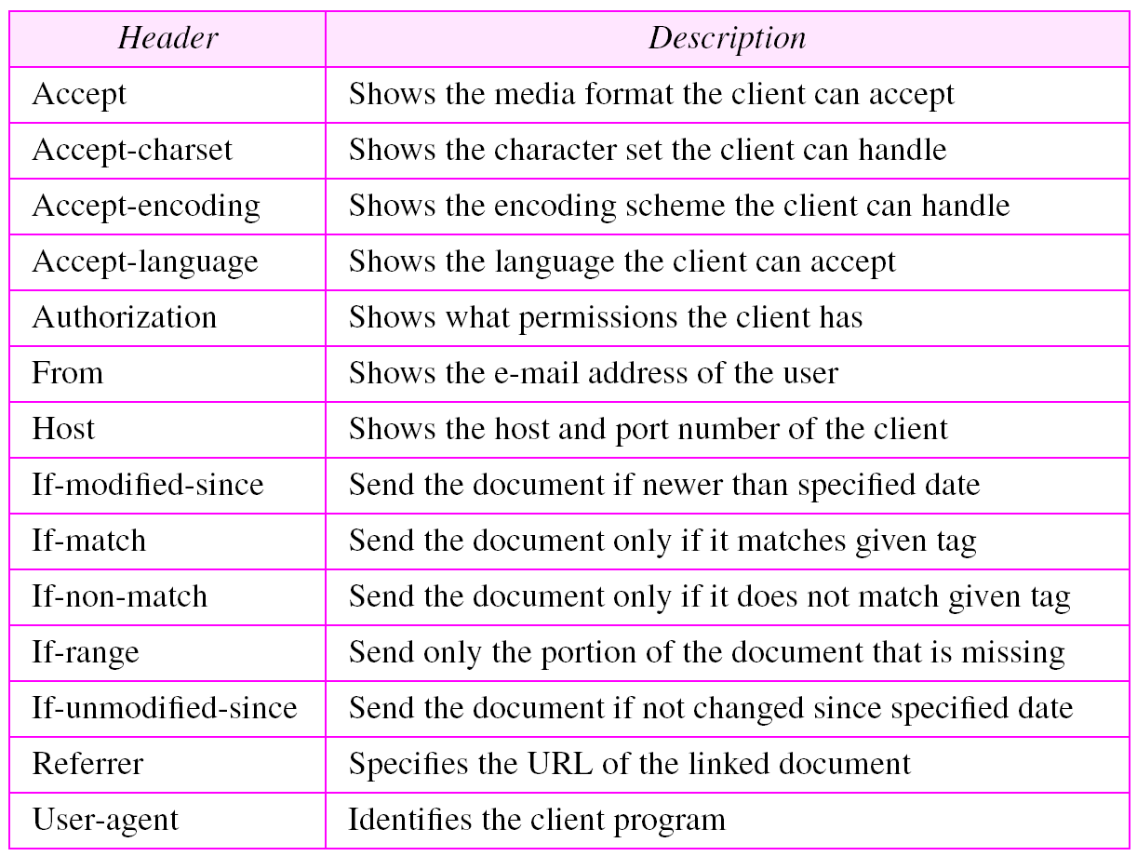
Request headers

Slide 31
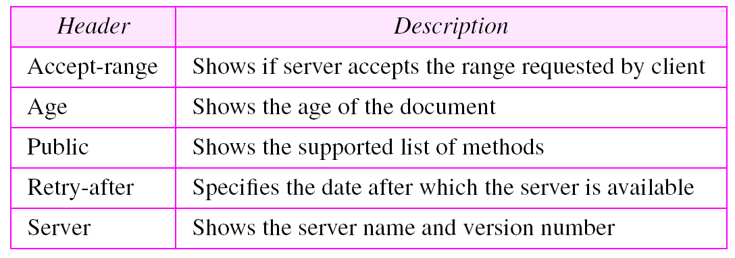
Response headers

Slide 32
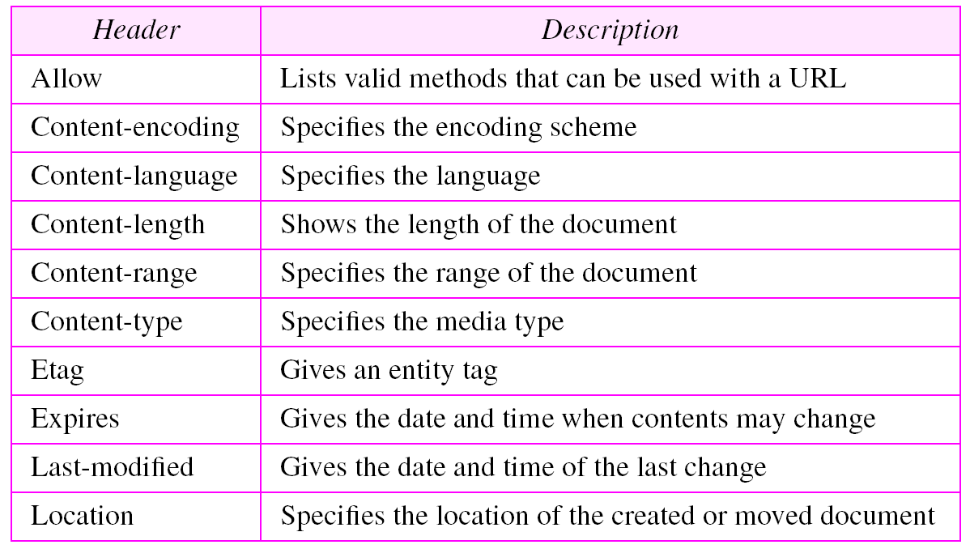
Entity headers

Slide 33
Cache control
Repository
Use of cache for system improvement.
Many web browsers store web pages viewed by client in cache memory, which brings efficiency in browsing web pages.
Ex- daily reading new paper.

Slide 34
Features of HTTP
Communication protocol between web browser & web server.
Based on request response messaging.
Stateless protocol, means doesn`t remember previous user information nor the number of times the user visited particular website.
Request response message consists plain text in readable form.
Cache control.

Slide 35
Distributed Multi-tiered Applications
The J2EE platform uses a multi-tiered distributed application model for both enterprise applications
Application logic is divided into “components” according to function, and the various application components that make up a J2EE application are installed on different machines depending on the tier in the multi-tiered J2EE environment to which the application component belongs

Slide 36
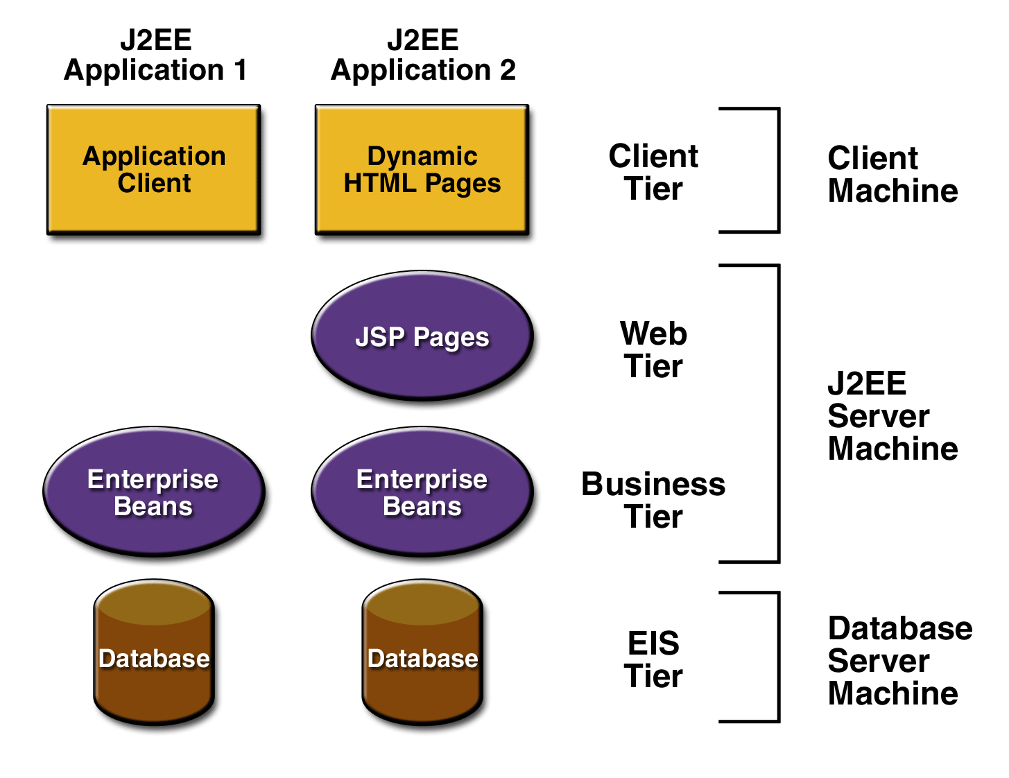
J2EE Architecture
J2EE multi-tiered applications are generally considered to be three-tiered applications because they are distributed over three different locations
client machines
the J2EE server machine
the database or legacy machines at the back end

Slide 37
J2EE Architecture
Three-tiered applications that run in this way extend the standard two-tiered client and server model by placing a multithreaded application server between the client application and back-end storage

Slide 38
Enterprise information tier(EIS)
Integration tier
Consists enterprise resources such as database or legacy system using which J2EE can make some transactions.
Depending on nature of project EIS will vary.
Various interfacing techniques
JDBC API for database
JNDI for naming & directory service

Slide 39
Middle Tier
Contains business objects
Connection pooling & transaction management
Middle tier components are independent of user interface.
Associated with server machine.

Slide 40
User interface tier
Consists of simple web applications that take care of GUI which can be handled easily by user.
Web application programs communicate with servlets in middle layer for conveying the user request.
Associated with client machine.

Slide 41
J2EE Containers
The application server maintains control and provides services through an interface or framework known as a container
There are five defined container types in the J2EE specification

Slide 42
J2EE Containers
Three of these are server-side containers:
The server itself, which provides the J2EE runtime environment and the other two containers
An EJB container to manage EJB components
A Web container :- Apache Tomcat to manage servlets and JSP pages
The other two container types are client-side:
An application container for stand-alone GUIs, console
An applet container, meaning a browser, usually with the Java Plug-in

Slide 43
J2EE Components
As said earlier, J2EE applications are made up of components
A J2EE component is a self-contained functional software unit that is assembled into a J2EE application with its related classes and files and that communicates with other components

Slide 44
Components
Client components run on the client machine, which correlate to the client containers
Web components -servlets and JSP pages
EJB Components

Slide 45
Packaging Applications and Components
Under J2EE, applications and components reside in Java Archive (JAR) files
These JARs are named with different extensions to denote their purpose, and the terminology is important

Slide 46
Various File types
Enterprise Archive (EAR) files represent the application, and contain all other server-side component archives that comprise the application
Client interface files and EJB components reside in JAR files
Web components reside in Web Archive (WAR) files

Slide 47
Deployment Descriptors
Deployment descriptors are included in the JARs, along with component-related resources
Deployment descriptors are XML documents that describe configuration and other deployment settings (remember that the J2EE application server controls many functional aspects of the services it provides)
The statements in the deployment descriptor are declarative instructions to the J2EE container; for example, transactional settings are defined in the deployment descriptor and implemented by the J2EE container

Slide 48
Deployment Descriptors
Most J2EE Web Services vendors provide a GUI tool for generating deployment descriptors and performing deployment because creating manual entries is tedious and error prone
The deployment descriptor for an EJB component must be named ejb-jar.xml, and it resides in the META-INF directory inside the EJB JAR file

Slide 49
EJB Components
EJB components are server-side, modular, and reusable, comprising specific units of functionality
They are similar to the Java classes we create every day, but are subject to special restrictions and must provide specific interfaces for container and client use and access
We should consider using EJB components for applications that require scalability, transactional processing, or availability to multiple client types

Slide 50
EJB Components- Major Types
Session beans
These may be either stateful or stateless and are primarily used to encapsulate business logic, carry out tasks on behalf of a client, and act as controllers or managers for other beans
Entity beans
Entity beans represent persistent objects or business concepts that exist beyond a specific application's lifetime; they are typically stored in a relational database

Slide 51
Web application
Accessed using intranet/internet in browser controlled environment.
Can be easily used on thousand of computer without installing any specialized software.
Examples: Online purchase systems, Mail services, Weather forecast services.
Implemented normally three tier architecture.
Presentation tier takes care of look & feel of web application.
HTML,DHTML,PHP

Slide 52
Middle tier is business logic which interacts with database
JSP,SERVLET,ASP,ASP.NET
Storage tier deals with database.
MYSQl, Oracle
For writing web application frame work is developed using which web application can be developed rapidly.
GET & POST to access web application.

Slide 53
Application server
Application server is a program that handles all operations between users & a backend business applications or databases.
High performance
High availability
Application framework that provides environment where applications run.
Includes servlets, JSP, EJB.
.NET framework is popular technology provided by Microsoft to support application server.

